Slide 2
COMP1206 - Programming 2
Lecture: Introduction to Software Testing & Unit Testing
Dr Jian Shi
Jian.Shi@soton.ac.uk

Slide 3
Topics
Software Testing
Unit Testing
Stub and Mock
Refactoring Techniques

Slide 4

Software Testing
Verification – software correctly implements a specific function
Validation – software satisfies customer requirements
Verification -
Are we doing the thing right?
Validation –
Are we doing the right thing?

Slide 5
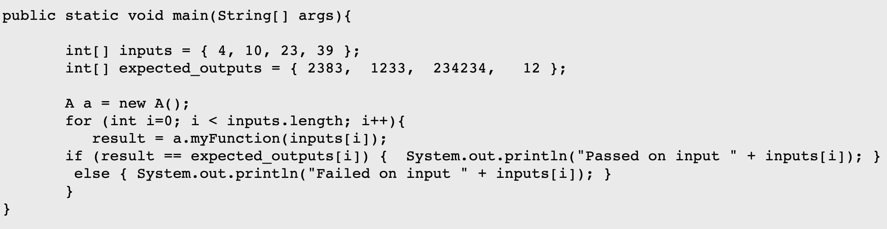
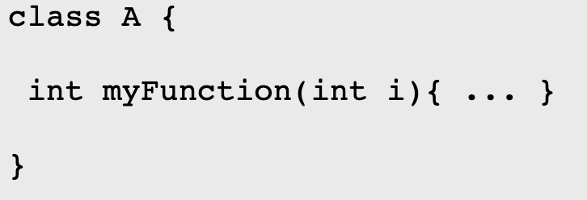
Software Testing
What is it?
Software is tested to uncover errors that were made inadvertently as it was designed and constructed.
Why is it important?
Testing often accounts for more project effort than any other software engineering activity.
What testing isn’t?
“I always test my code. I always run it a few times after I've finished writing the bit of code I've been working on.”

Slide 6
Types of Testing
Functionality Testing
Regression Testing
Performance Testing, Scalability Testing, Stress Testing
Usability Testing
Security Testing
Installation Testing
User Acceptance, α and β Testing

Slide 7
White-Box & Black-Box Testing
 | White-Box Testing | Black-Box Testing
Definition | Internal structure is known to the tester. | Used to test the software without the knowledge of the internal structure of program or application.
Emphasis | Whether methods/data structures work correctly | The relationship between input and output behaviours
Knowledge | Both programming and implementation knowledge are needed | Both programming and implementation knowledge are NOT needed
Tested By | Usually done by tester and developers | Performed by the end user, developer, and tester
Code Access | Required. Thereby, the code could be stolen if testing is outsourced | NOT required
*More explanation available on module note page.

Slide 8
Unit, Integration and System Testing
 | Unit Testing | Integration Testing | System Testing
Refer to | Testing code in small isolated pieces | Repeatedly testing the combination of larger and larger collections of code units | Testing the entirety of a developed system and its installation
When | Anytime | After Unit but before System | End of development
Kind | White box | Mixed | Black box
Executed by | Developers | Testers | Developers and testers
*More explanation about Integration Testing will be considered in future lectures.

Slide 9
Unit Testing Methodology
Extra cost of writing unit tests throughout development actually improves long-term productivity.
Benefits
Less time to write tests
Early bug detection
Improve design decisions
Enhance test documentation
Encourage better code
Faster and Safer
To ensure the productivity, tests should:
Run fast: test small bits of code in isolation
Simplicity: only assert what is required
Be developed in parallel with the code

Slide 10

How to Do a Unit Test?
Identify the code that will be tested in isolation
Develop a suite of test cases
Write a test harness to support the execution of each case in the suite
For each case:
SetUp
TearDown

Slide 11
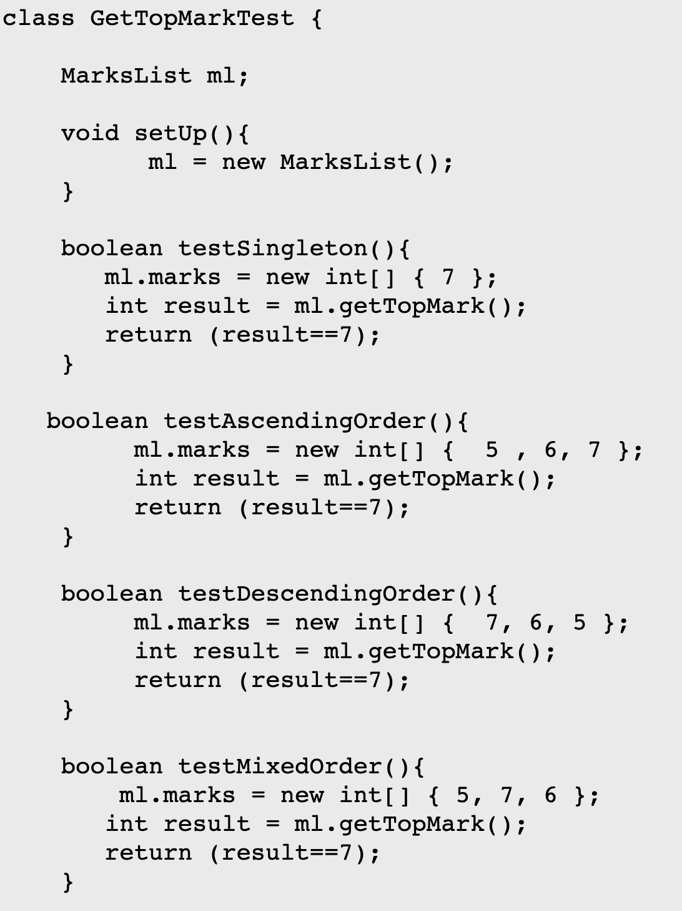
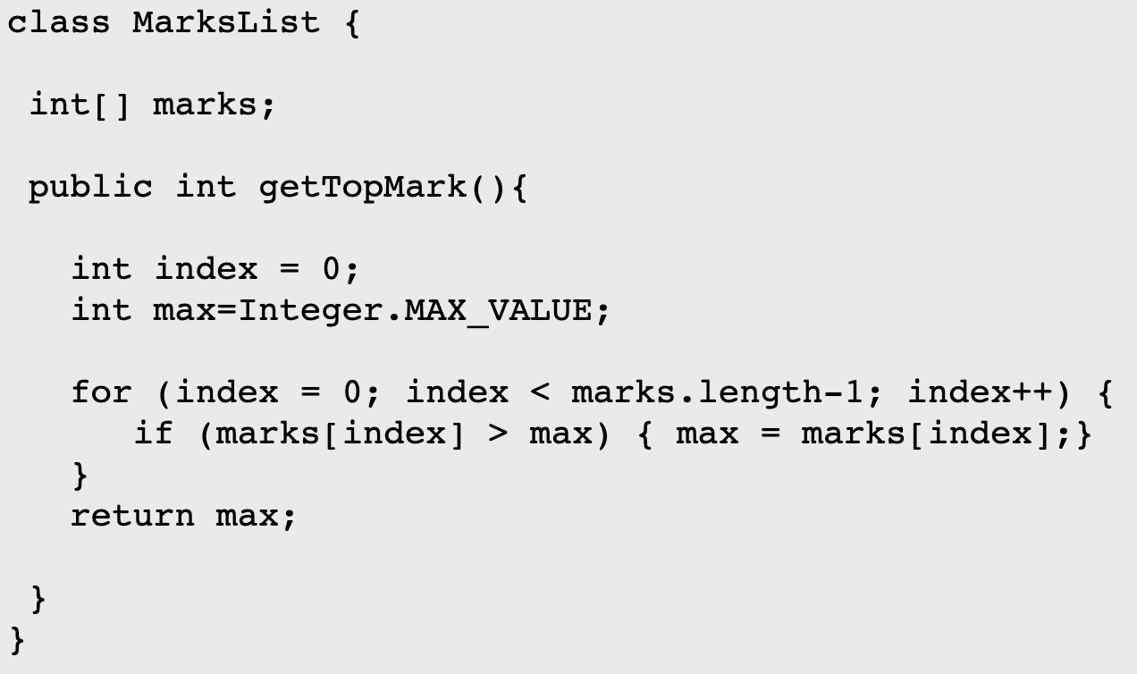
Hand-Coding Unit Test Example
Test

Slide 12
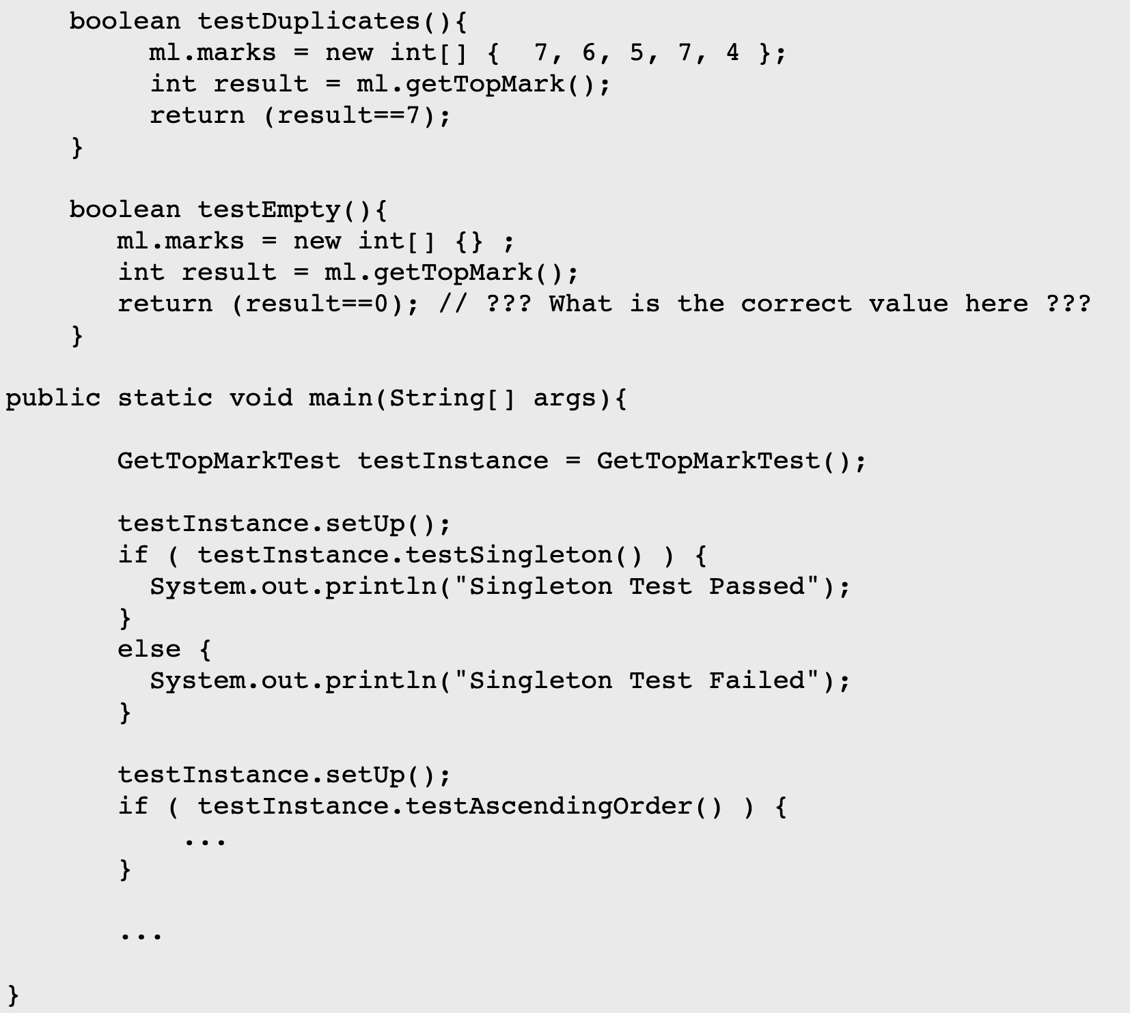

Unit Test Example
ALL FAILED!
WHY?
Result

Slide 13
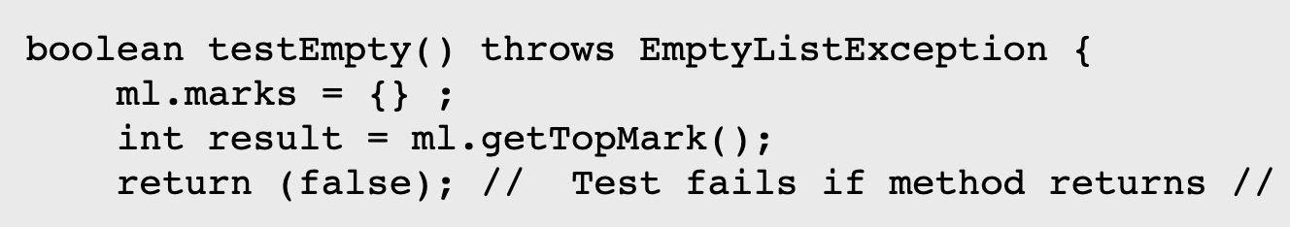
Lessons Learned from the Epic Fail
Hand-coding test is expensive and tedious
Tests won’t necessarily find all the problems
Tests can reveal issues that perhaps weren’t mentioned in the specification
Negative tests missed, so max = 0 is incorrect.
Issue of empty list

Slide 14
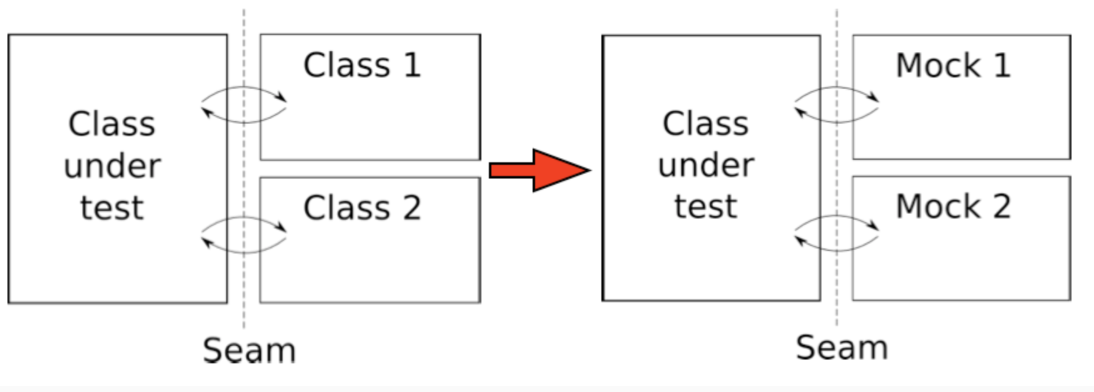
Mock
Seam - the boundary between the unit under test and other classes that the unit collaborates with.
Unit is being tested in isolation - all collaborating objects on the other side of the seam for a given unit must be replaced somehow.

Slide 15
Mock
Pros
We assume correctness of class B so we are not susceptible to errors external to the unit.
We don't need to have actually implemented class B yet.
We don't need to affect any external resources that class B might interact with.
We can speed up execution of the test if method m is to be computationally expensive.
Cons
Extra work - create mock versions of class B
Solution
Build a mock subclass of B
instances of these mock classes are called Mock Objects

Slide 16

Code Refactor
Mocking isn’t all that easy though. Anti-patterns exist:
Exposes calls to static methods
Class under test creates an instance of an external class itself
Stub class
A stub is a controllable replacement for an external dependency.
Code to test:
Class A
External:
Class B
Proxy calls
Stub Class:
Class B’
Mock Object:
Mock B’

Slide 17
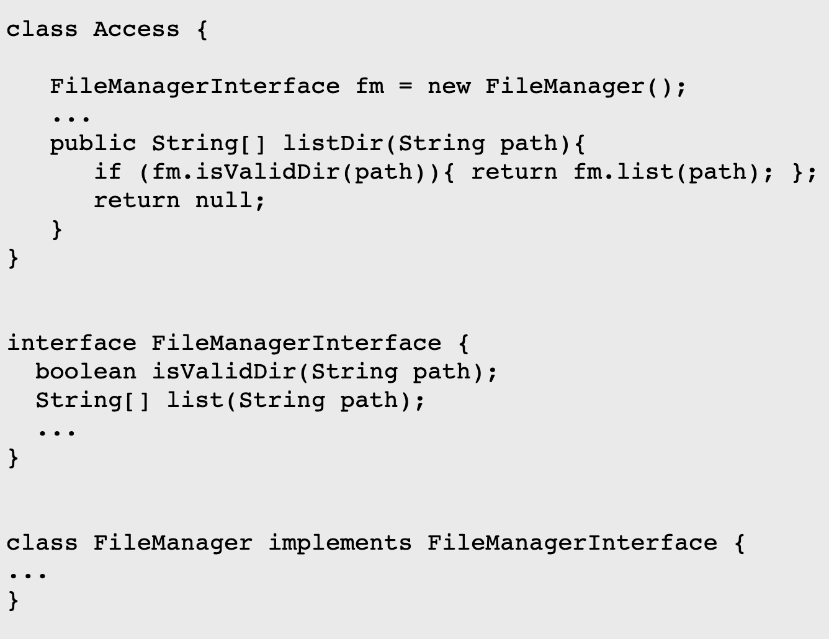
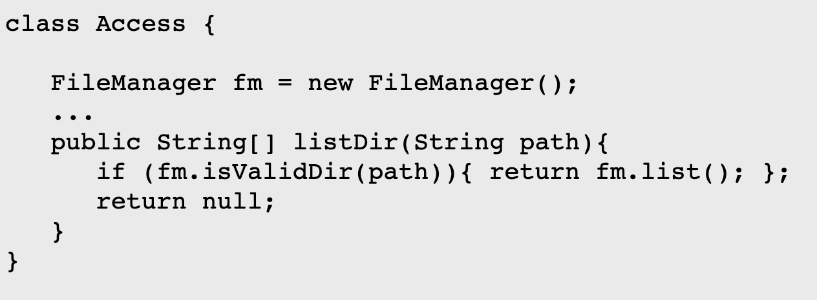
Refactoring Techniques
Use stub classes at the boundaries to the system.
Extract an interface to external dependencies to allow stub injection, e.g.

Slide 18
Refactoring Techniques
Dependency Injection
Inject a stub implementation via a constructor
Inject a stub implementation via mutator methods
Use factory methods to construct instances of loosely coupled classes
Class Person:
Person(Friend)
External:
Class Friend

Slide 19
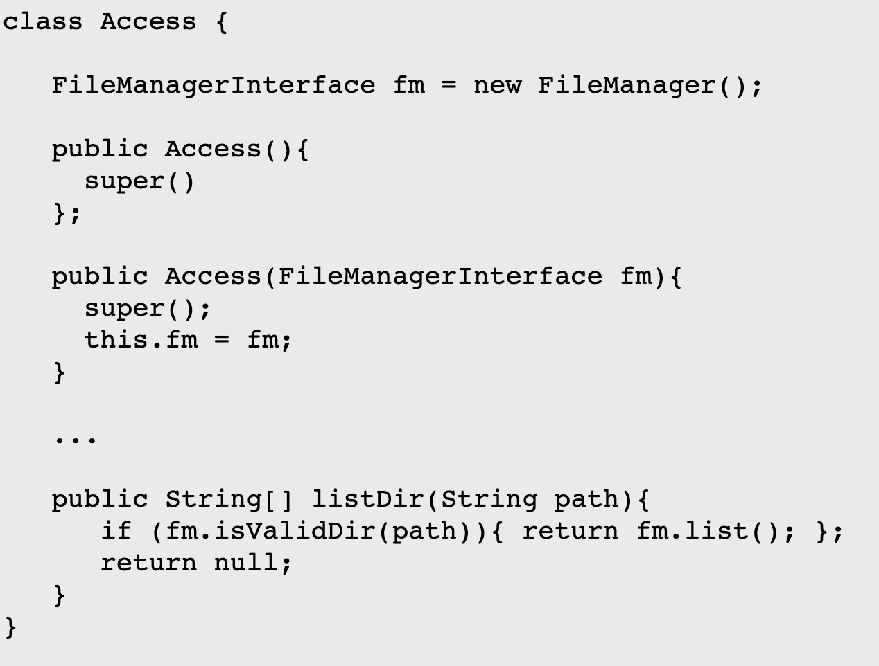
Constructor Injection
;

Slide 20
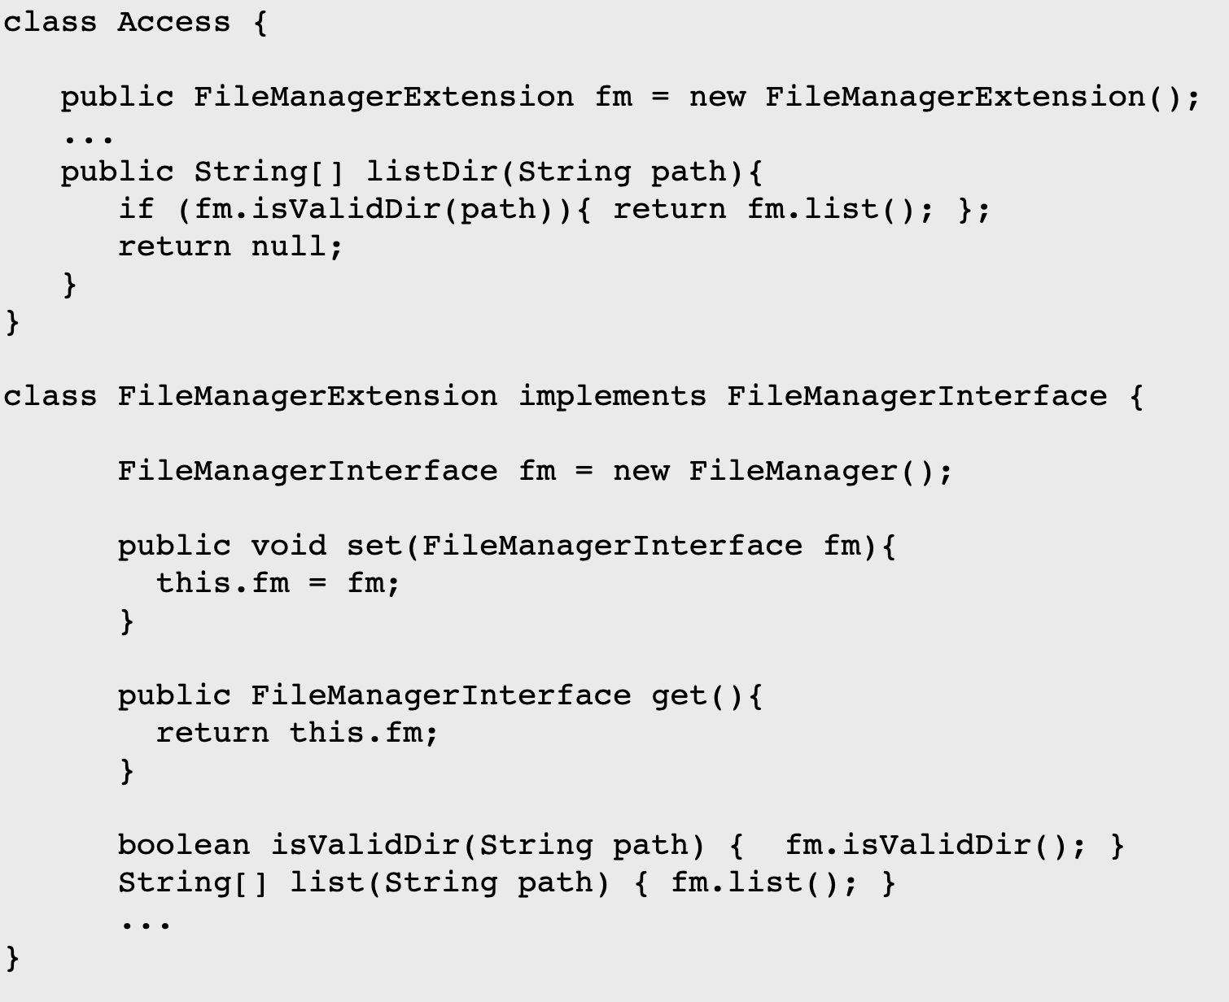
Setter/Getter Injection

Slide 21
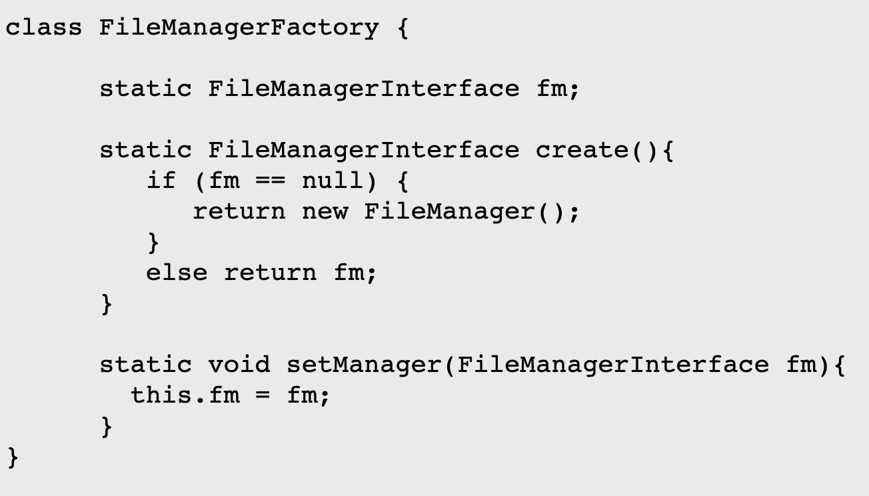
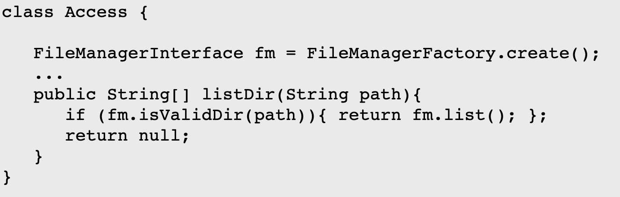
Factory Method Injection

Slide 22
Summary
Testing your programs is more than just running them to see what happens.
There are many different kinds of testing and you can test different parts of the system separately
Unit and Integration testing can be performed in parallel with coding - this can aid long term productivity, but affect short term productivity adversely.
Automation of testing and tool support will help massively.
Isolating units for unit testing is not always easy - there are design strategies to help with this.

Slide 23
Thanks for watching!

